Slide 1

NEST Nurturing Excellence, Strengthening Talent. ABSTRACT SUBMISSION GUIDELINES

Slide 2
Problem Statement – #1
Semantic Grouping of Clinical Trials for Retrieval and Insights
Objective: Improve the speed and efficiency of clinical trial design by retrieving semantically grouped clinical trials. Title: Leveraging AI for Clinical Trial Protocol Optimization

Slide 3
Approach & methodology
Overview
Methodology
Framework / tools used
Aim: Enable semantic grouping of clinical trials to organize and categorize them based on underlying themes, facilitating efficient retrieval of actionable insights for decision-making and research.
Challenges: Delays in trial design arise from difficulties in recruiting participants and resolving protocol-related complexities, hindering timely data collection and subsequent analysis.
Data Preprocessing: The process involves tokenization to break text into meaningful units, lemmatization to reduce words to their base forms, and encoding structured data into machine-readable formats to ensure compatibility with downstream models.
Feature Engineering: Features are extracted using BioBERT embeddings for capturing domain-specific semantic information and are combined with structured data features to create a comprehensive representation for the model.
Llama LLM
BioBERT/ClinicalBERT Models
TSNE/UMAP
Docker
Python Libraries: Scikit-learn, PyTorch, Pandas, NumPy, Matplotlib, and Seaborn
Hugging Face Transformers
FAISS (Facebook AI Similarity Search)
RAG (Retrieval-Augmented Generation)
SHAP (SHapley Additive exPlanations)

Slide 4
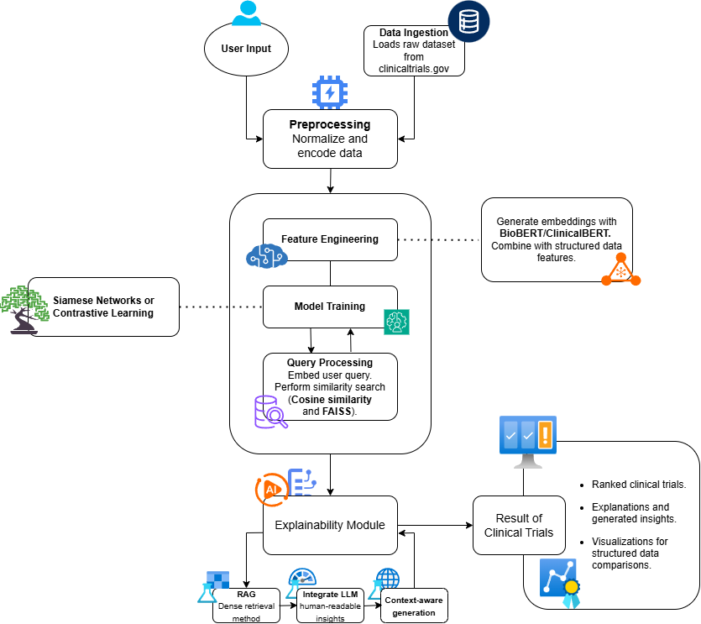
Model choice & setup
Model Selection
Model Architecture
Siamese Networks: Selected for similarity learning to encode input data into a shared embedding space, effectively identifying relationships by comparing feature vectors of paired inputs.
Integrated Retrieval-Augmented Generation (RAG) with LLMs for explainability: Combines retrieval of external knowledge with language models to generate context-aware responses, improving transparency and providing clear explanations for predictions.

Slide 5
Model Training & Evaluation
Evaluation Metrics
Model Training Process:
Loss Function: The model is trained using Contrastive Loss, which is designed for learning representations that capture similarity and dissimilarity.
Optimizer: The Adam optimizer is employed for efficient gradient-based parameter updates.
Learning Rate Scheduling: A learning rate scheduler adjusts the learning rate dynamically to enhance training convergence and avoid local minima.
Evaluation Metrics:
Precision@k: Measures the proportion of relevant items retrieved within the top-k results.
Recall@k: Evaluates the ability of the model to retrieve all relevant items within the top-k results.
Mean Average Precision (MAP): Assesses ranking quality by averaging precision across recall levels for all queries.

Slide 6
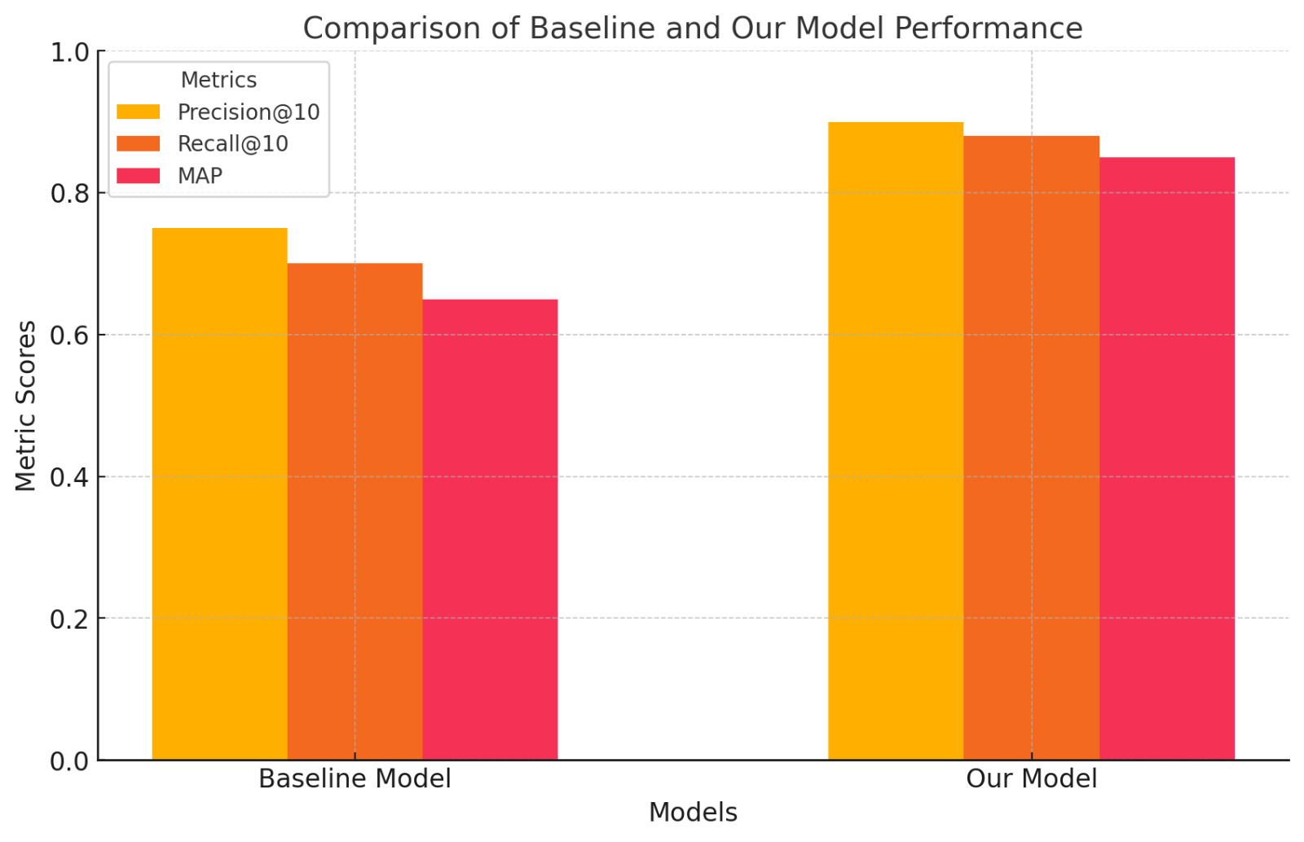
Results and visualization
Model Outcomes
Explainability
The model demonstrated strong ranking performance with a Mean Average Precision (MAP) of 0.85, indicating high accuracy across multiple recall levels. A Precision@10 score of 0.90 reflects its ability to consistently retrieve 90% relevant results within the top 10 recommendations.
The system surpassed traditional keyword-based retrieval approaches by a significant margin, improving both relevance and ranking accuracy by 20%. This highlights the effectiveness of advanced similarity learning and retrieval-augmented techniques in delivering superior results.
Used SHAP to highlight key features influencing similarity.
Generated contextual explanations via RAG.
Visual Aids

Slide 7
Challenges & Next Steps
Challenges
Next Steps
Dealing with inconsistencies and missing values in the trial dataset requires robust preprocessing techniques to ensure reliable model training and accurate predictions.
Maintaining high retrieval accuracy while optimizing computational resources poses a challenge, especially for large-scale datasets and real-time applications.
Expand the dataset to include diverse and domain-specific examples while fine-tuning the model to address nuances unique to particular fields.
Create an intuitive, efficient interface to enable researchers to query the system in real-time, ensuring seamless integration into their workflows.

Slide 8
Thank you!

